Slide 1

COCO: A Platform for Comparing Continuous Optimizers Effortlessly
Dimo Brockhoff
dimo.brockhoff@inria.fr
Permission to make digital or hard copies of part or all of this work for personal or classroom use is granted without fee provided that copies are not made or distributed for profit or commercial advantage and that copies bear this notice and the full citation on the first page. Copyrights for third-party components of this work must be honored. For all other uses, contact the Owner/Author.
Copyright is held by the owner/author(s).
GECCO '14, Jul 12-16 2014, Vancouver, BC, Canada
ACM 978-1-4503-2881-4/14/07.
http://dx.doi.org/10.1145/2598394.2605339

Slide 2
optimization problems are ubiquitous

Slide 3


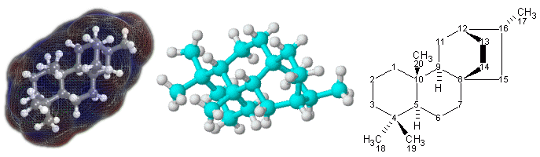
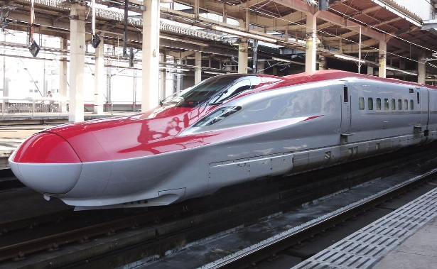

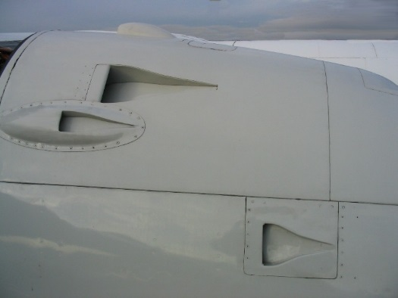

challenging optimization problems
appear in many
scientific, technological and industrial domains

Slide 4
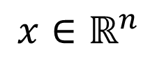
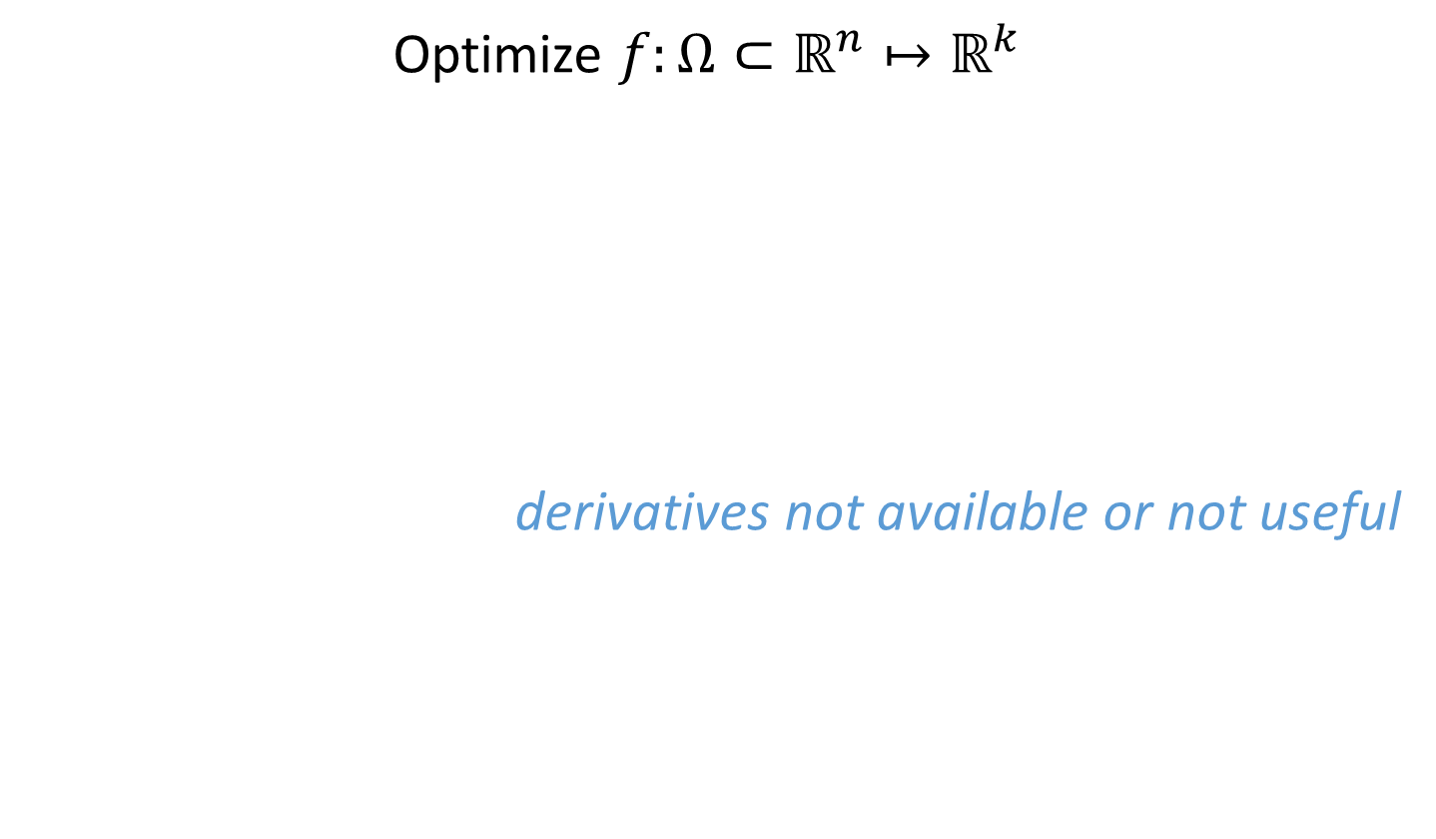
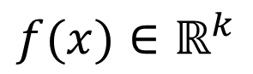
Numerical Blackbox Optimization
Optimize $f:Ω⊂ℝ^{n}↦ℝ^{k}$
derivatives not available or not useful
$$x∈ℝ^{n}$$
$$f(x)∈ℝ^{k}$$

Slide 5
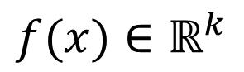
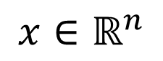
Practical Blackbox Optimization
Given:
Not clear:
which of the many algorithms should I use on my problem?
$$x∈ℝ^{n}$$
$$f(x)∈ℝ^{k}$$

Slide 6
Numerical Blackbox Optimizers
Deterministic algorithms
Quasi-Newton with estimation of gradient (BFGS) [Broyden et al. 1970]
Simplex downhill [Nelder & Mead 1965]
Pattern search [Hooke and Jeeves 1961]
Trust-region methods (NEWUOA, BOBYQA) [Powell 2006, 2009]
Stochastic (randomized) search methods
Evolutionary Algorithms (continuous domain)
Differential Evolution [Storn & Price 1997]
Particle Swarm Optimization [Kennedy & Eberhart 1995]
Evolution Strategies, CMA-ES [Rechenberg 1965, Hansen & Ostermeier 2001]
Estimation of Distribution Algorithms (EDAs) [Larrañaga, Lozano, 2002]
Cross Entropy Method (same as EDA) [Rubinstein, Kroese, 2004]
Genetic Algorithms [Holland 1975, Goldberg 1989]
Simulated annealing [Kirkpatrick et al. 1983]
Simultaneous perturbation stochastic approx. (SPSA) [Spall 2000]

Slide 7
Numerical Blackbox Optimizers
Deterministic algorithms
Quasi-Newton with estimation of gradient (BFGS) [Broyden et al. 1970]
Simplex downhill [Nelder & Mead 1965]
Pattern search [Hooke and Jeeves 1961]
Trust-region methods (NEWUOA, BOBYQA) [Powell 2006, 2009]
Stochastic (randomized) search methods
Evolutionary Algorithms (continuous domain)
Differential Evolution [Storn & Price 1997]
Particle Swarm Optimization [Kennedy & Eberhart 1995]
Evolution Strategies, CMA-ES [Rechenberg 1965, Hansen & Ostermeier 2001]
Estimation of Distribution Algorithms (EDAs) [Larrañaga, Lozano, 2002]
Cross Entropy Method (same as EDA) [Rubinstein, Kroese, 2004]
Genetic Algorithms [Holland 1975, Goldberg 1989]
Simulated annealing [Kirkpatrick et al. 1983]
Simultaneous perturbation stochastic approx. (SPSA) [Spall 2000]
choice typically not immediately clear
although practitioners have knowledge about which difficulties their problem has (e.g. multi-modality, non-separability, ...)

Slide 8
Need: Benchmarking
understanding of algorithms
algorithm selection
putting algorithms to a standardized test
simplify judgement
simplify comparison
regression test under algorithm changes
Kind of everybody has to do it (and it is tedious):
choosing (and implementing) problems, performance measures, visualization, stat. tests, ...
running a set of algorithms

Slide 9
that's where COCO comes into play

Slide 10
automatized benchmarking

Slide 11
How to benchmark algorithms with COCO?

Slide 12
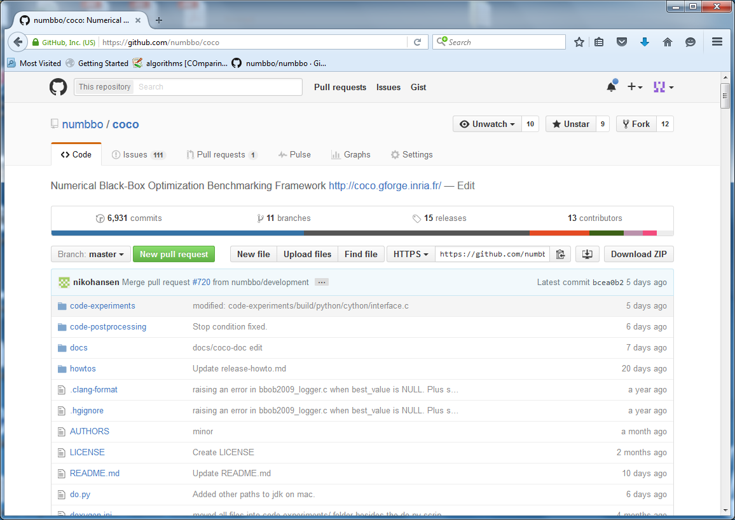
https://github.com/numbbo/coco

Slide 13
https://github.com/numbbo/coco

Slide 14
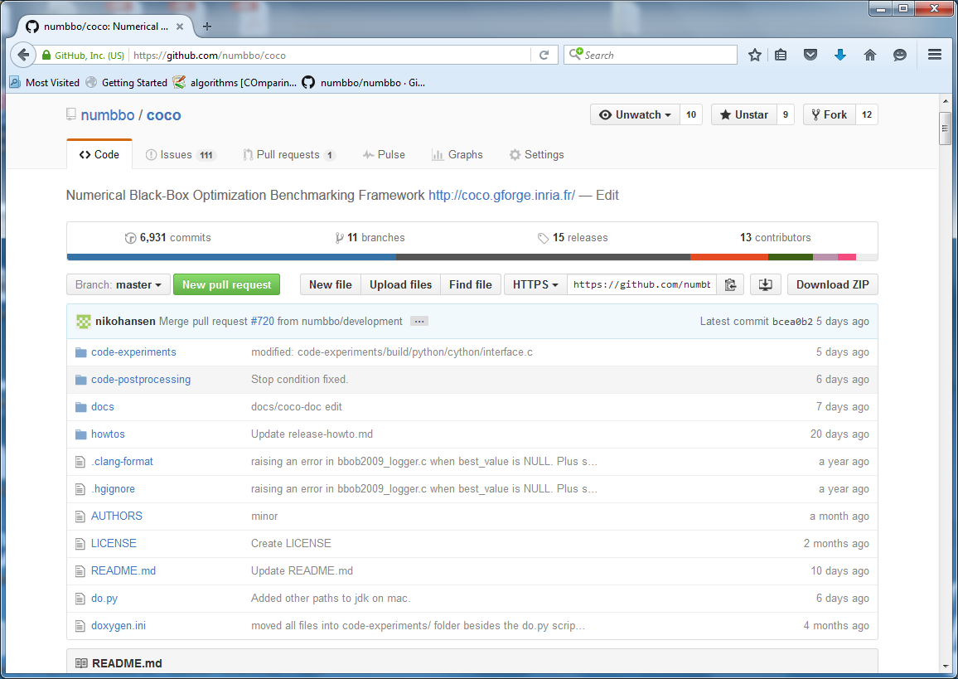
https://github.com/numbbo/coco

Slide 15
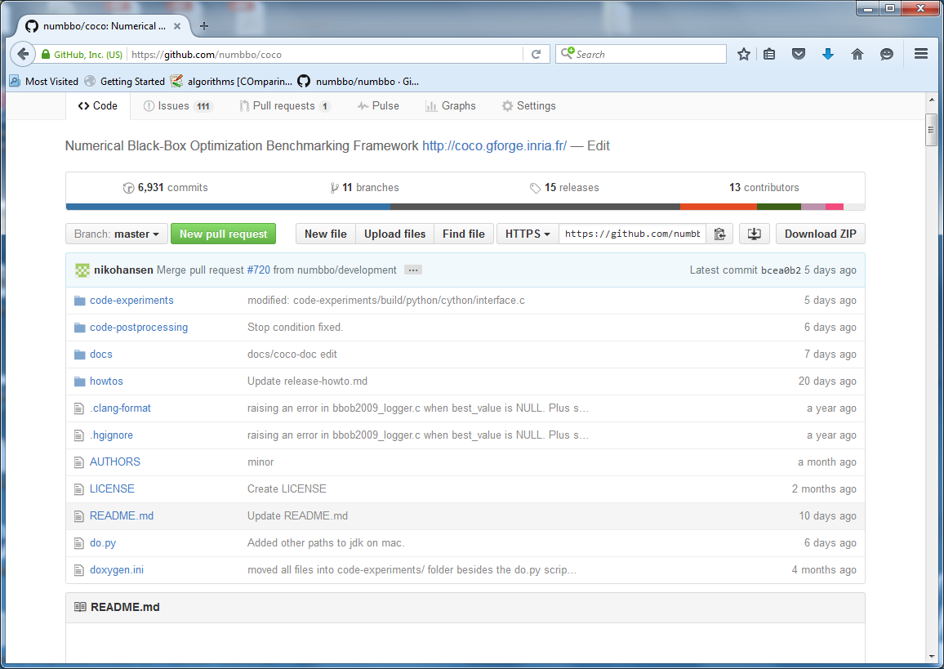
https://github.com/numbbo/coco

Slide 16
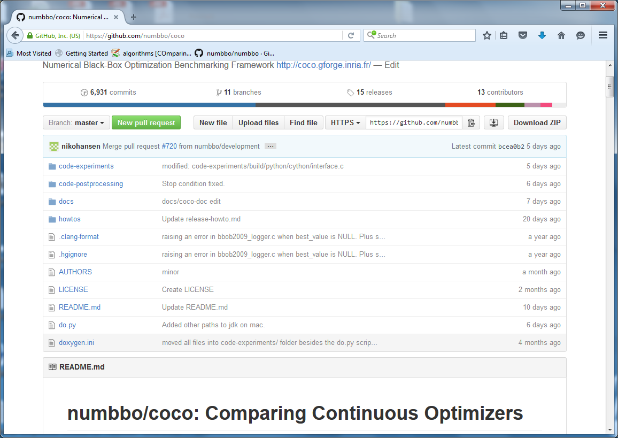
https://github.com/numbbo/coco

Slide 17
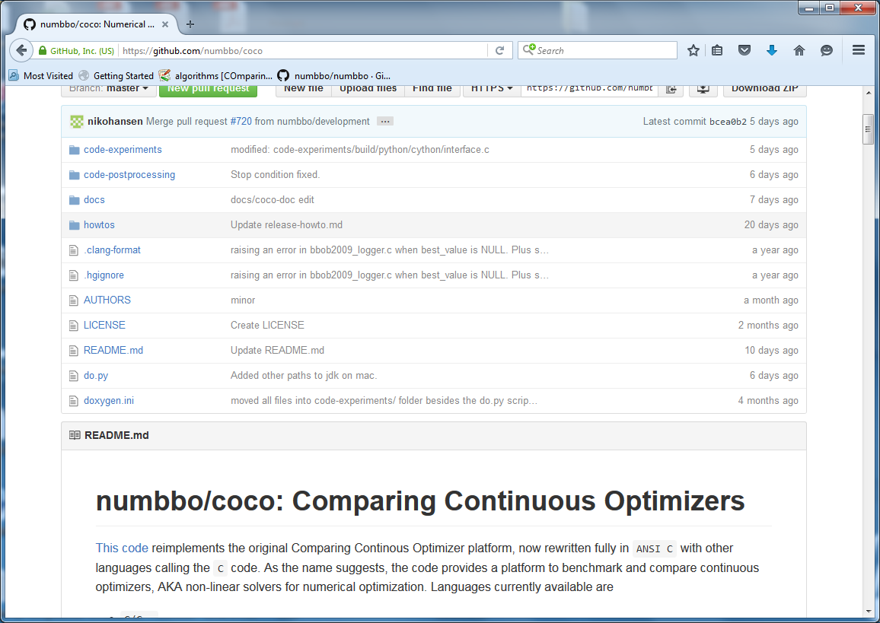
https://github.com/numbbo/coco

Slide 18
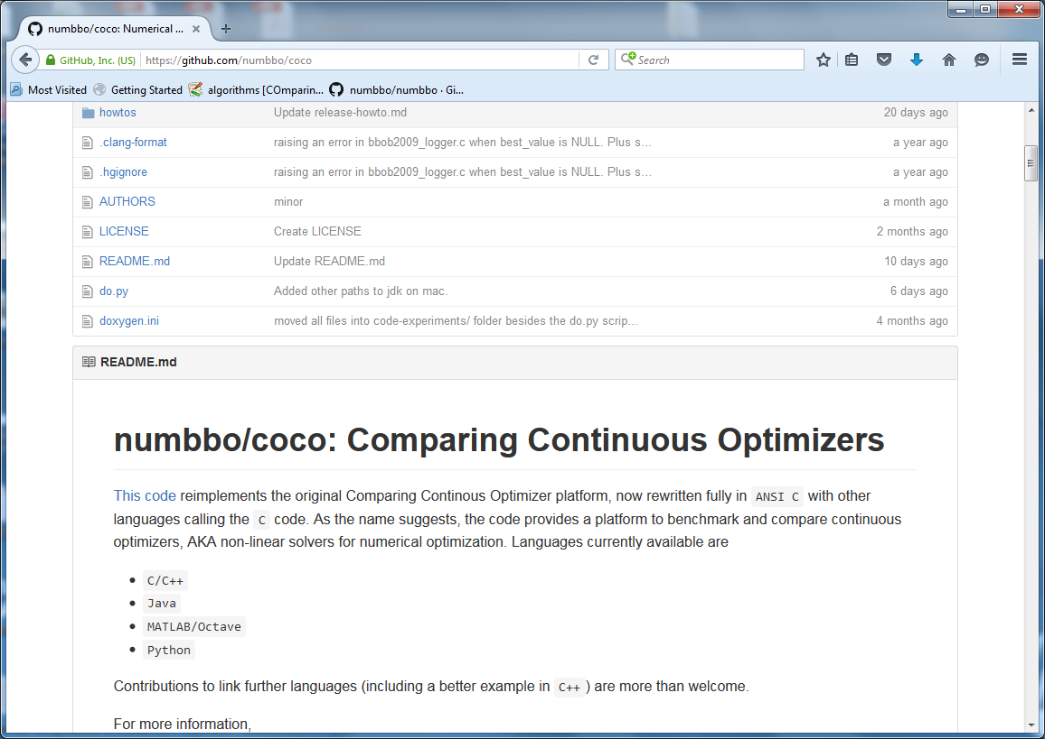
https://github.com/numbbo/coco

Slide 19
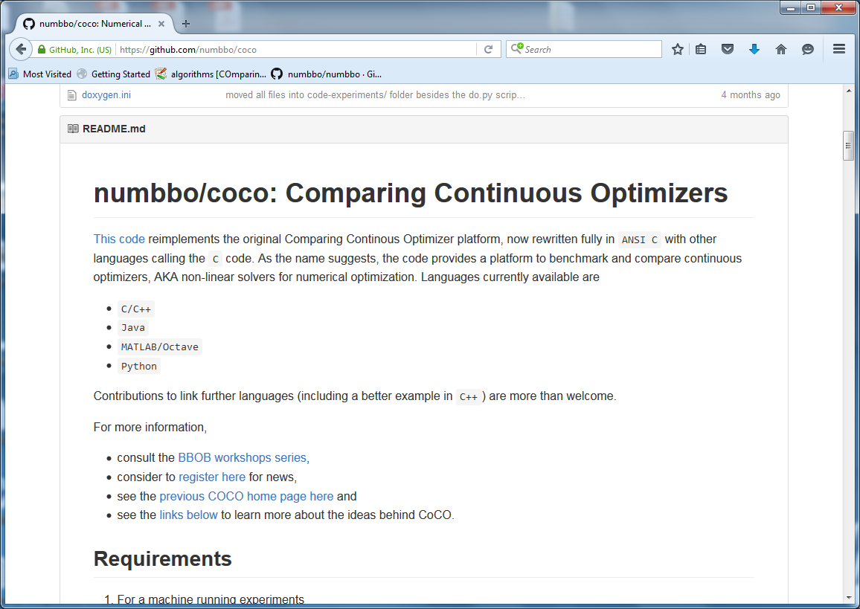
https://github.com/numbbo/coco

Slide 20
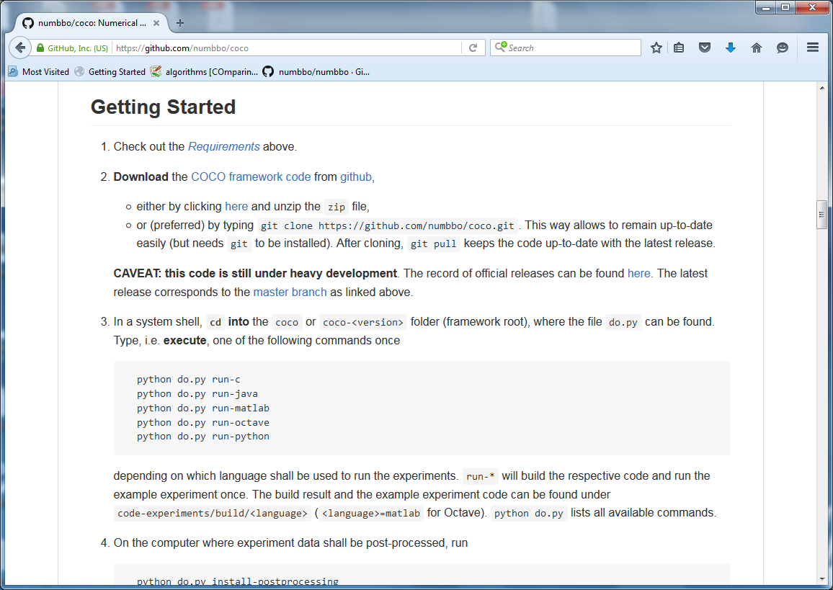
https://github.com/numbbo/coco

Slide 21
https://github.com/numbbo/coco

Slide 22
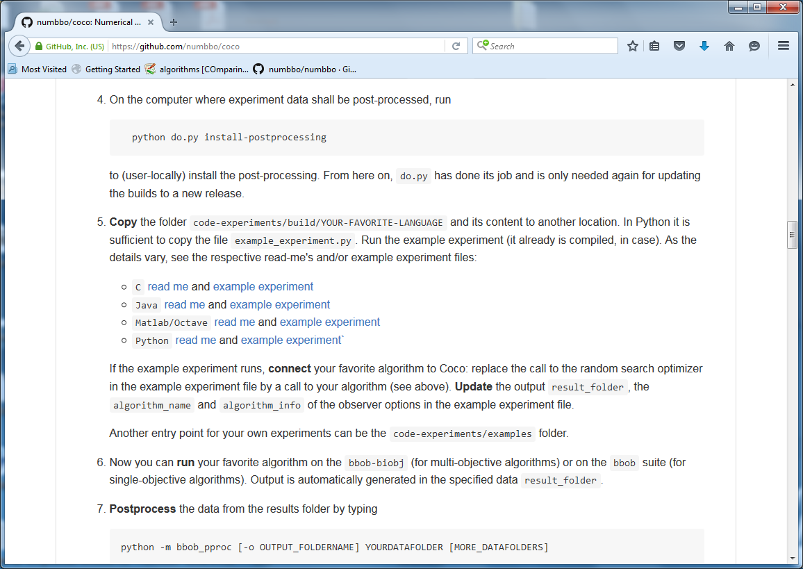
https://github.com/numbbo/coco

Slide 23
https://github.com/numbbo/coco

Slide 24
example_experiment.c
/* Iterate over all problems in the suite */
while ((PROBLEM = coco_suite_get_next_problem(suite, observer)) != NULL) {
size_t dimension = coco_problem_get_dimension(PROBLEM);
/* Run the algorithm at least once */
for (run = 1; run <= 1 + INDEPENDENT_RESTARTS; run++) {
size_t evaluations_done = coco_problem_get_evaluations(PROBLEM);
long evaluations_remaining =
(long)(dimension * BUDGET_MULTIPLIER) – (long)evaluations_done;
if (... || (evaluations_remaining <= 0))
break;
my_random_search(evaluate_function, dimension,
coco_problem_get_number_of_objectives(PROBLEM), coco_problem_get_smallest_values_of_interest(PROBLEM), coco_problem_get_largest_values_of_interest(PROBLEM),
(size_t) evaluations_remaining,
random_generator);
}

Slide 25
example_experiment.c
/* Iterate over all problems in the suite */
while ((PROBLEM = coco_suite_get_next_problem(suite, observer)) != NULL) {
size_t dimension = coco_problem_get_dimension(PROBLEM);
/* Run the algorithm at least once */
for (run = 1; run <= 1 + INDEPENDENT_RESTARTS; run++) {
size_t evaluations_done = coco_problem_get_evaluations(PROBLEM);
long evaluations_remaining =
(long)(dimension * BUDGET_MULTIPLIER) – (long)evaluations_done;
if (... || (evaluations_remaining <= 0))
break;
my_random_search(evaluate_function, dimension,
coco_problem_get_number_of_objectives(PROBLEM), coco_problem_get_smallest_values_of_interest(PROBLEM), coco_problem_get_largest_values_of_interest(PROBLEM),
(size_t) evaluations_remaining,
random_generator);
}

Slide 26
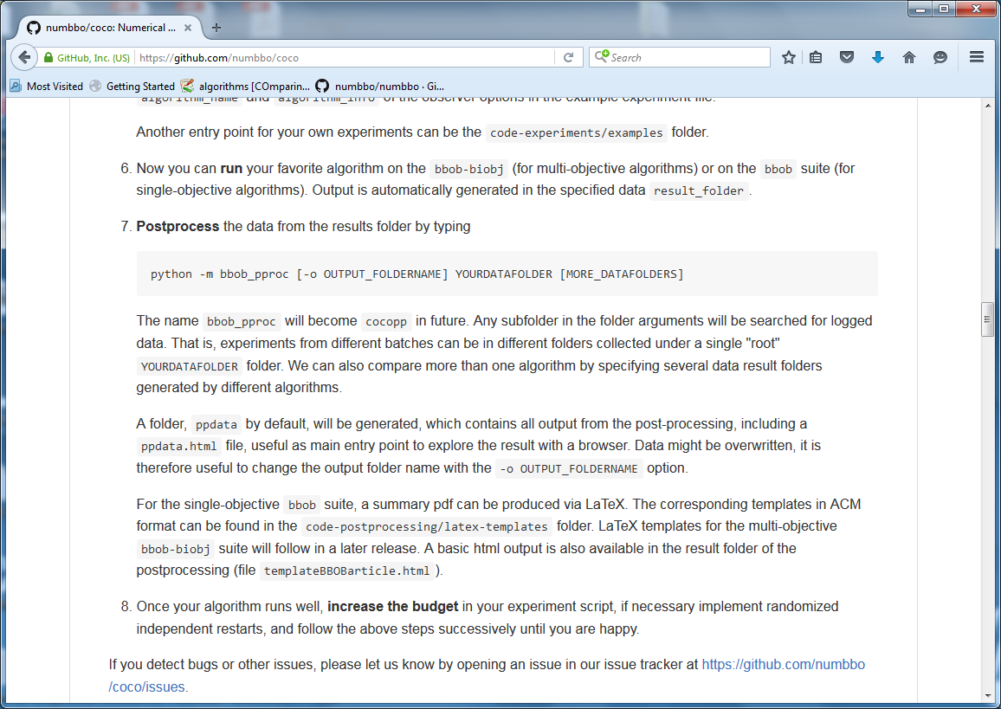
https://github.com/numbbo/coco

Slide 27
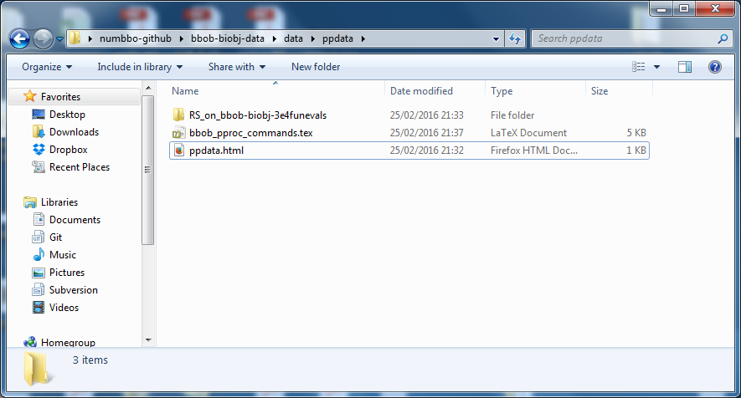
result folder

Slide 28
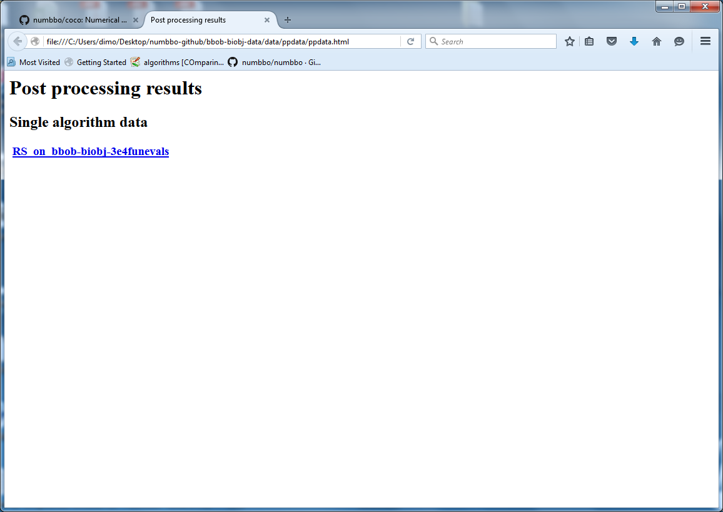
automatically generated results

Slide 29
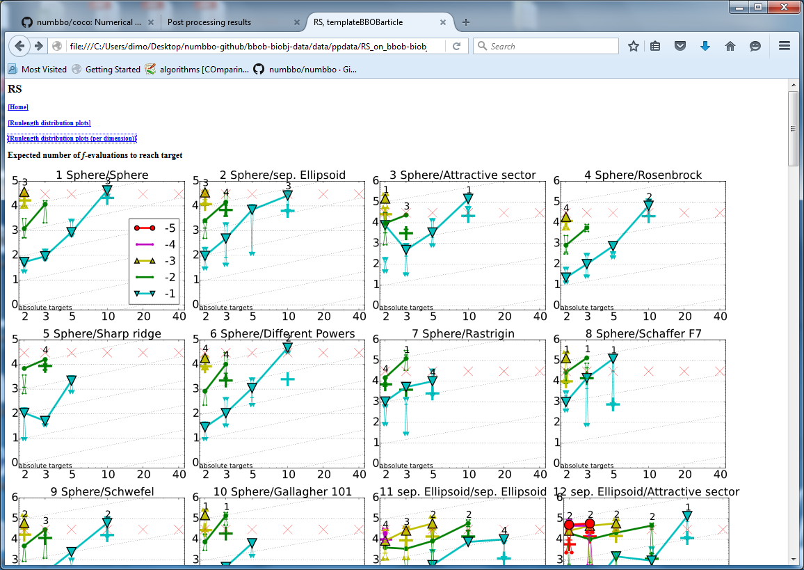
automatically generated results

Slide 30
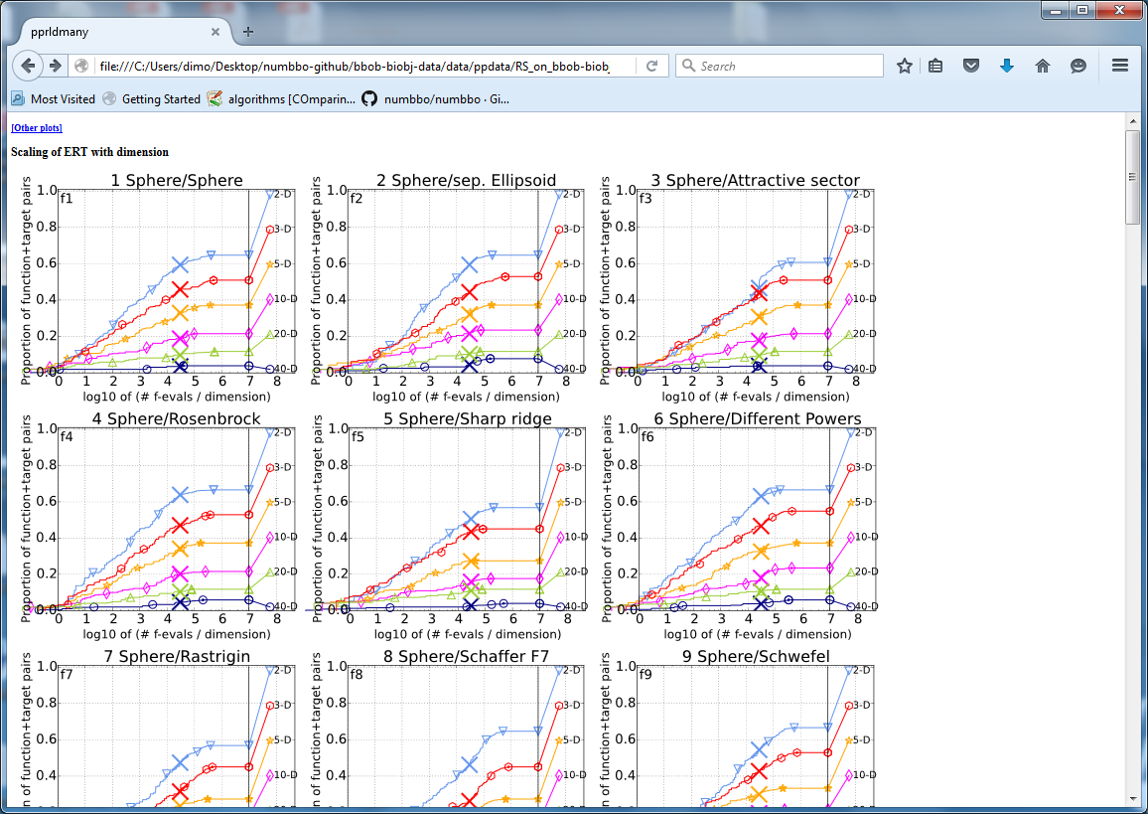
automatically generated results

Slide 31
doesn't look too complicated, does it?
[the devil is in the details ☺]

Slide 32
so far:
data for about 150 algorithm variants
118 workshop papers
by 79 authors from 25 countries

Slide 33
Measuring Performance
On
real world problems
expensive
comparison typically limited to certain domains
experts have limited interest to publish
"artificial" benchmark functions
cheap
controlled
data acquisition is comparatively easy
problem of representativeness

Slide 34
Test Functions
define the "scientific question"
the relevance can hardly be overestimated
should represent "reality"
are often too simple?
remind separability
a number of testbeds are around
account for invariance properties
prediction of performance is based on “similarity”, ideally equivalence classes of functions

Slide 35
Available Test Suites in COCO
bbob 24 noiseless fcts 140+ algo data sets
bbob-noisy 30 noisy fcts 40+ algo data sets
bbob-biobj 55 bi-objective fcts in 2016
Under development:
large-scale versions
linearly constrained test suite
Long-term goals:
combining difficulties
almost real-world problems
real-world problems
new

Slide 36
How Do We Measure Performance?
Meaningful quantitative measure
quantitative on the ratio scale (highest possible)
"algo A is two times better than algo B" is a meaningful statement
assume a wide range of values
meaningful (interpretable) with regard to the real world
possible to transfer from benchmarking to real world

Slide 37
runtime or first hitting time is the prime candidate (we don't have many choices anyway)

Slide 38
How Do We Measure Performance?
Two objectives:
Find solution with small(est possible) function value
With the least possible search costs (number of function evaluations)
For measuring performance: fix one and measure the other

Slide 39
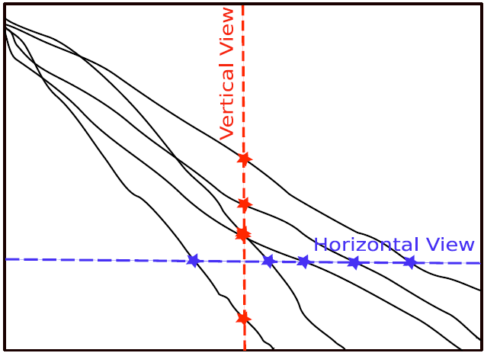
Measuring Performance Empirically
convergence graphs is all we have to start with...
fixed cost
five repetitions
(best achieved) function value
fixed target
number of function evaluations (time)

Slide 40
Measuring Performance Empirically
convergence graphs is all we have to start with...
fixed cost
five repetitions
(best achieved) function value
fixed target
number of function evaluations (time)

Slide 41
ECDF:
Empirical Cumulative Distribution Function of the Runtime
[aka data profile]

Slide 42
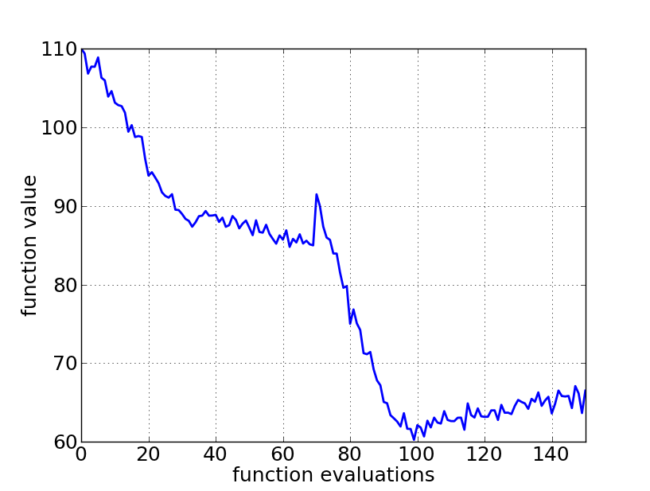
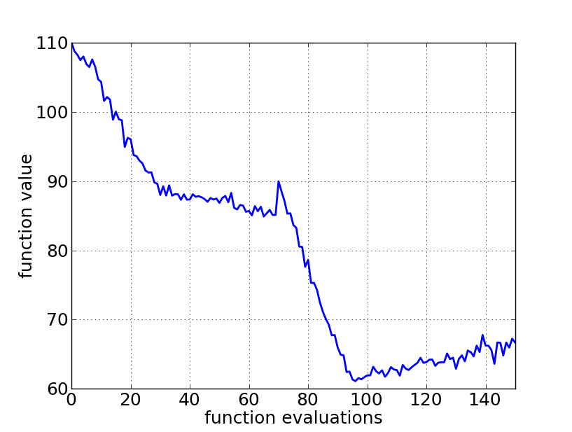

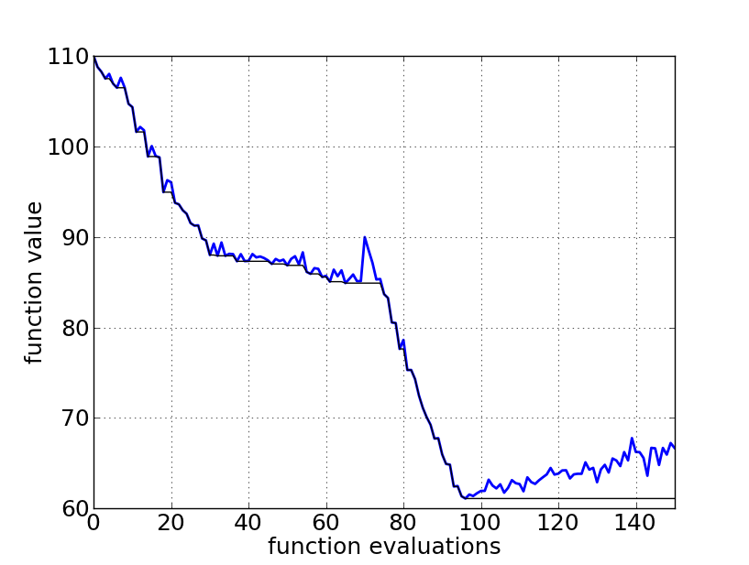
A Convergence Graph
A Convergence Graph

Slide 43
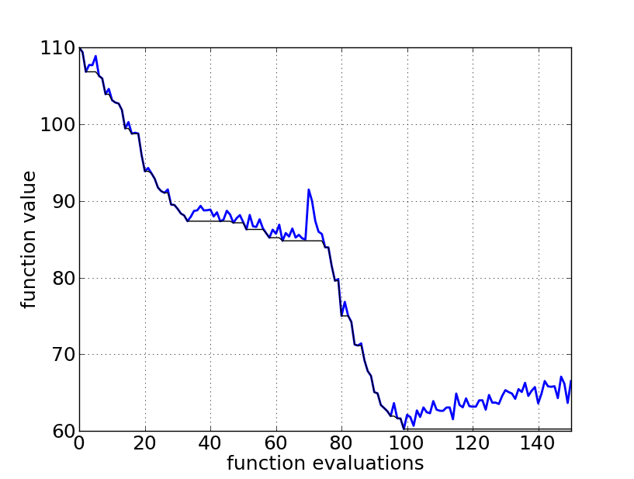
First Hitting Time is Monotonous

Slide 44
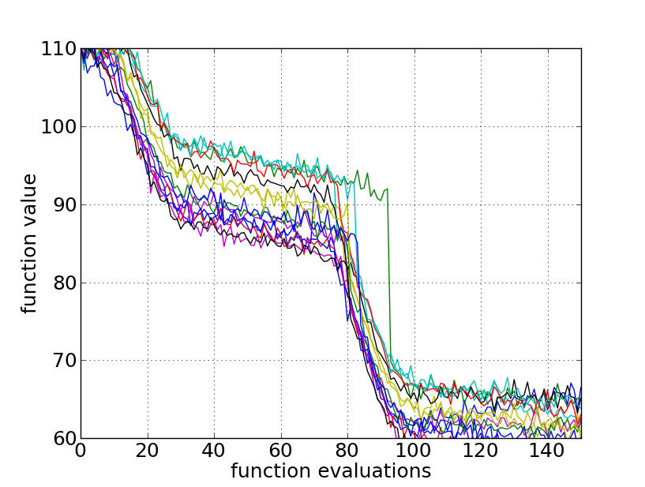
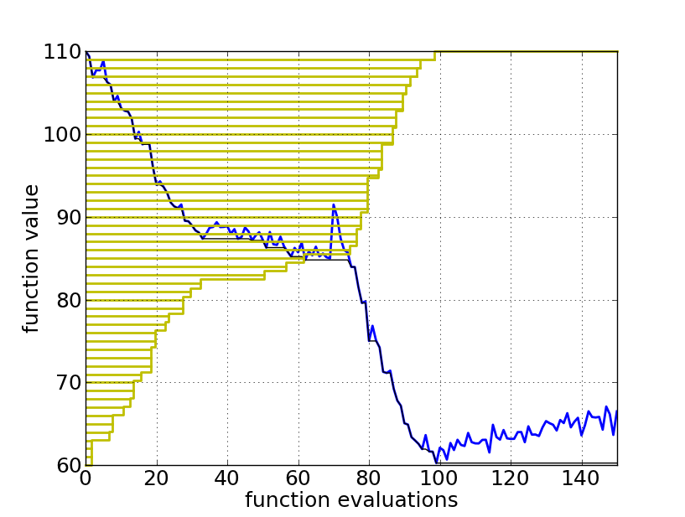
15 Runs

Slide 45
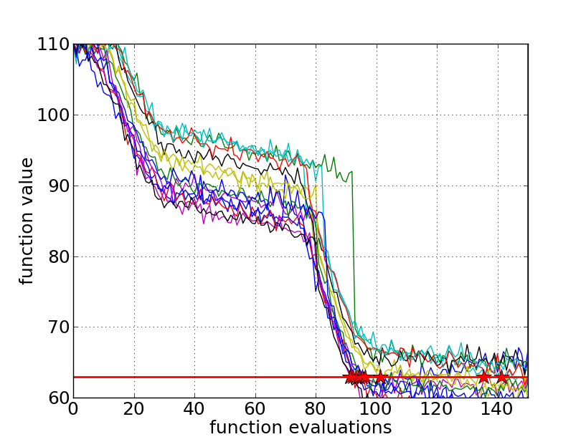
15 Runs ≤ 15 Runtime Data Points
target

Slide 46
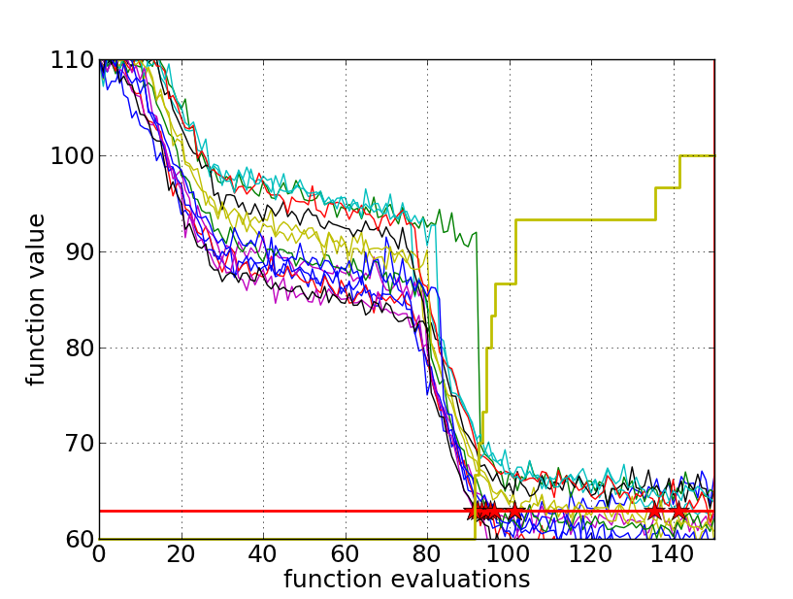
Empirical CDF
Empirical Cumulative Distribution
1
0.8
0.6
0.4
0.2
0
the ECDF of run lengths to reach the target
has for each data point a vertical step of constant size
displays for each x-value (budget) the count of observations to the left (first hitting times)
e.g. 60% of the runs need between 2000 and 4000 evaluations
e.g. 80% of the runs reached the target

Slide 47
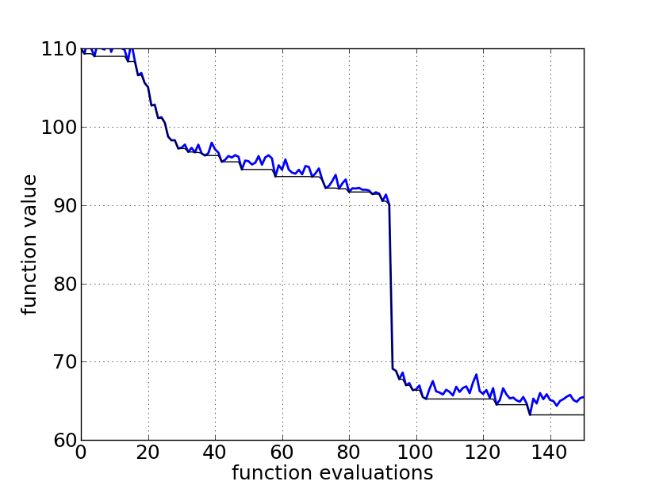
Reconstructing A Single Run

Slide 48
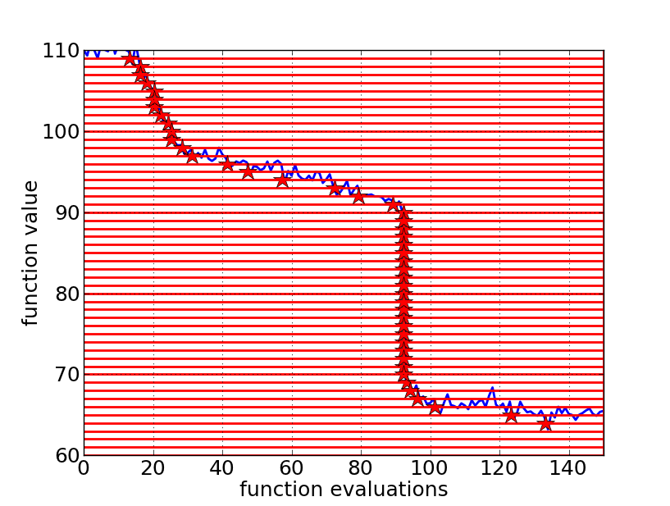
Reconstructing A Single Run
50 equally
spaced targets

Slide 49
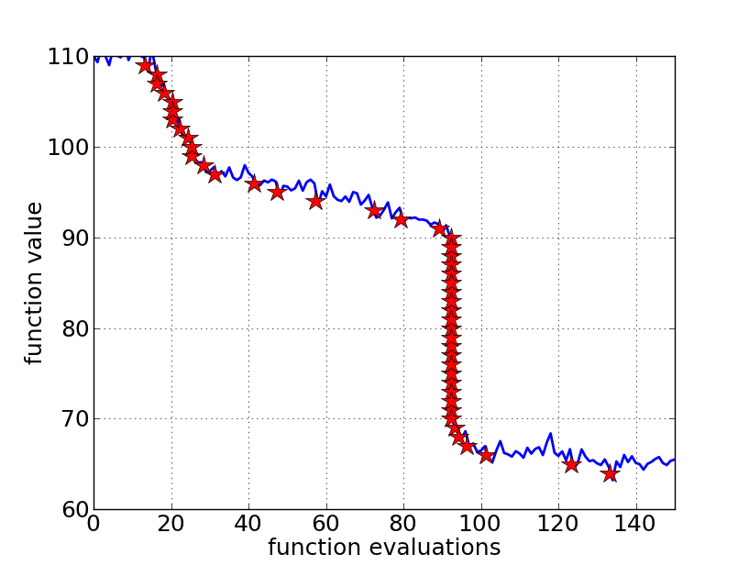
Reconstructing A Single Run

Slide 50
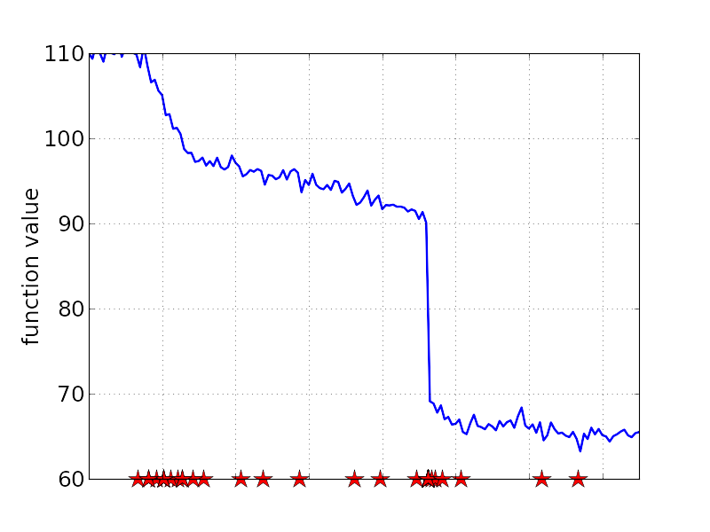
Reconstructing A Single Run

Slide 51
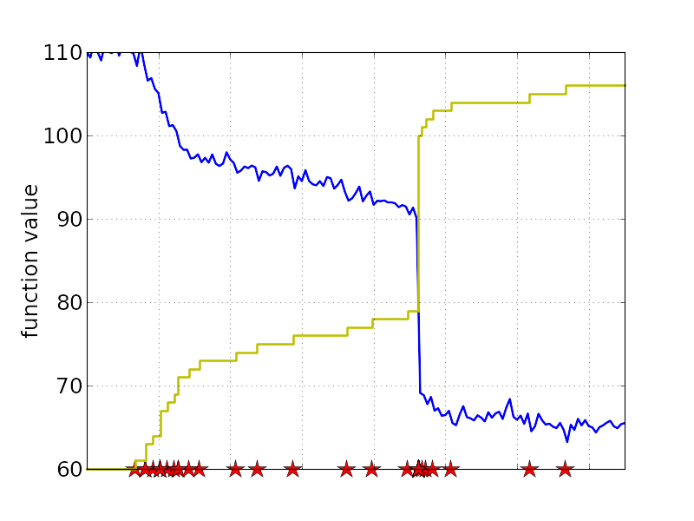
Reconstructing A Single Run
1
0.8
0.6
0.4
0.2
0
the empirical CDF makes a step for each star, is monotonous and displays for each budget the fraction of targets achieved within the budget

Slide 52
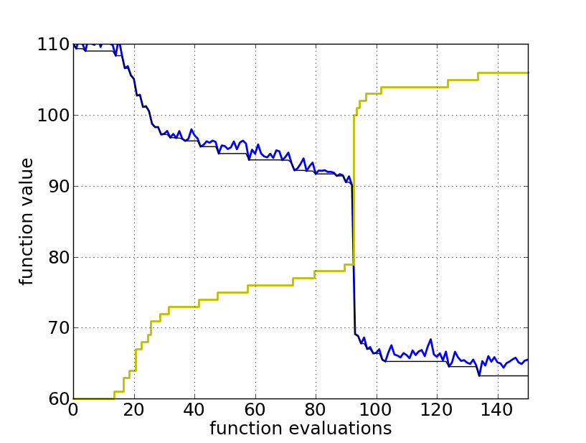
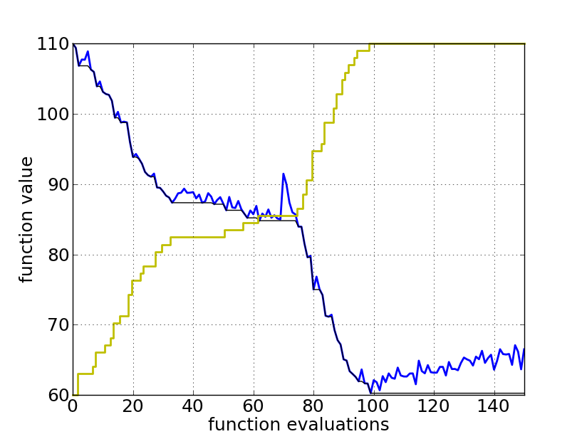
Reconstructing A Single Run
1
0.8
0.6
0.4
0.2
0
the ECDF recovers the monotonous graph, discretised and flipped

Slide 53
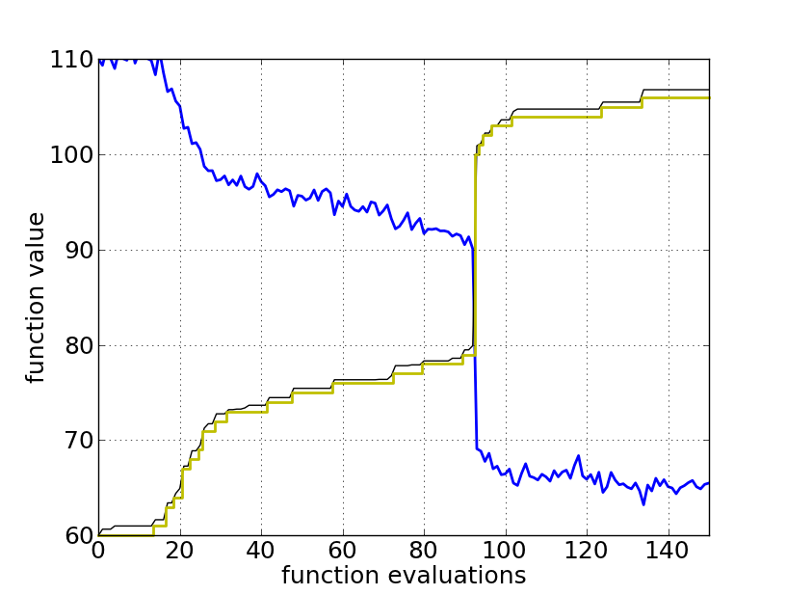
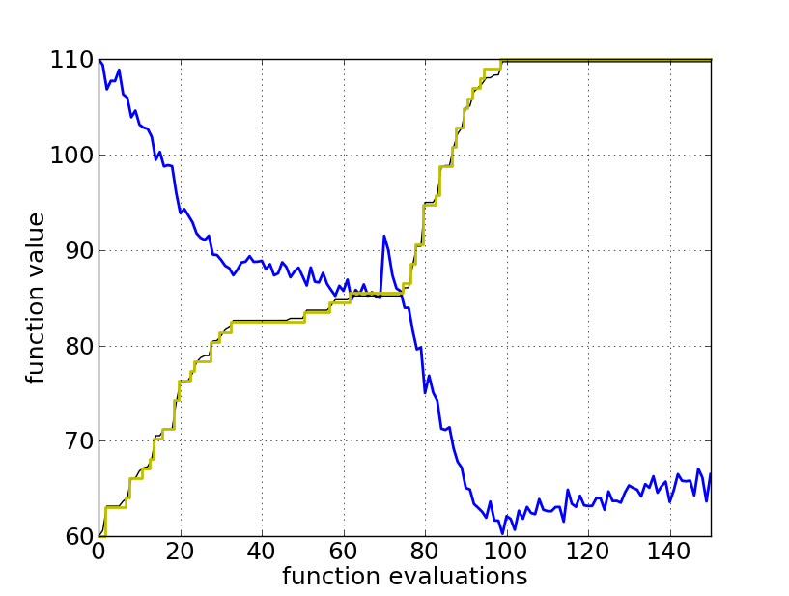
Reconstructing A Single Run
1
0.8
0.6
0.4
0.2
0
the ECDF recovers the monotonous graph, discretised and flipped

Slide 54
Aggregation
15 runs

Slide 55
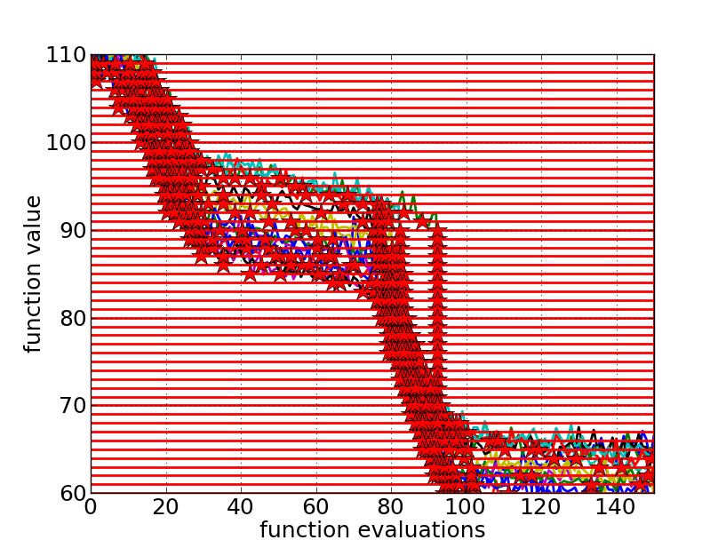
Aggregation
15 runs
50 targets

Slide 56
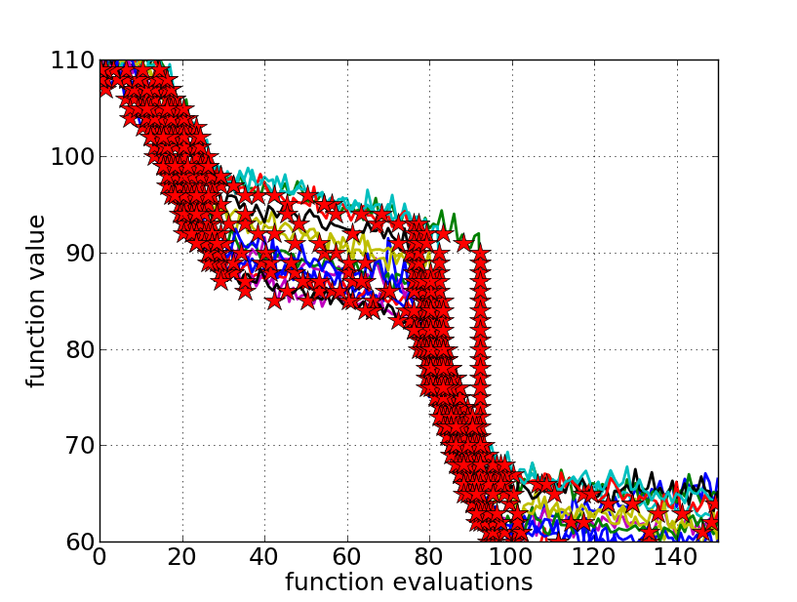
Aggregation
15 runs
50 targets

Slide 57
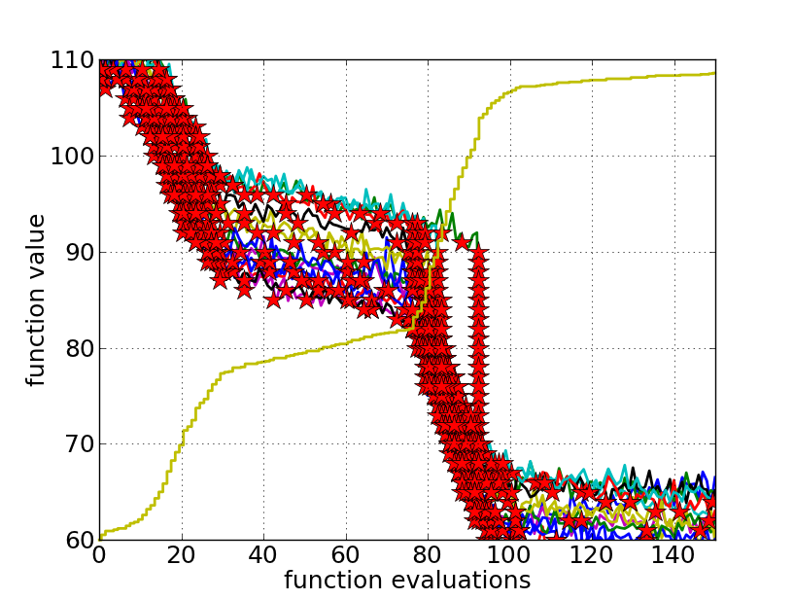
Aggregation
15 runs
50 targets
ECDF with 750 steps

Slide 58
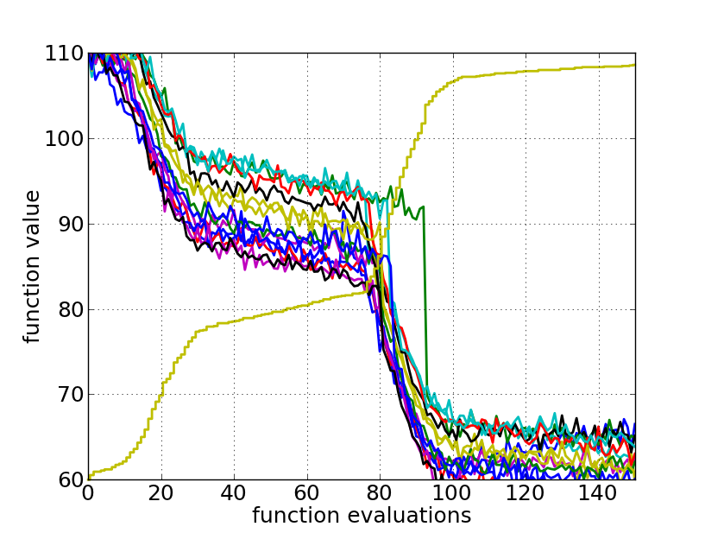
Aggregation
50 targets from 15 runs
...integrated in a single graph

Slide 59
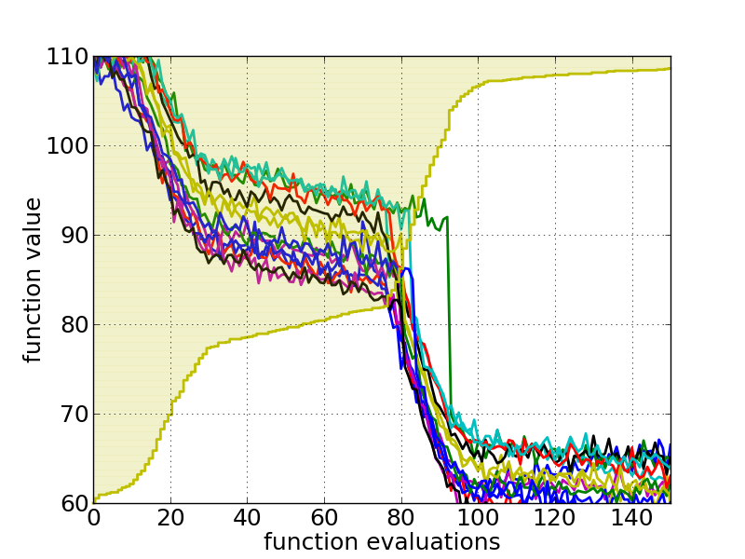
Interpretation
50 targets from 15 runs integrated in a single graph
area over the ECDF curve
=
average log runtime
(or geometric avg. runtime) over all targets (difficult and easy) and all runs

Slide 60
phew ;-)

Slide 61
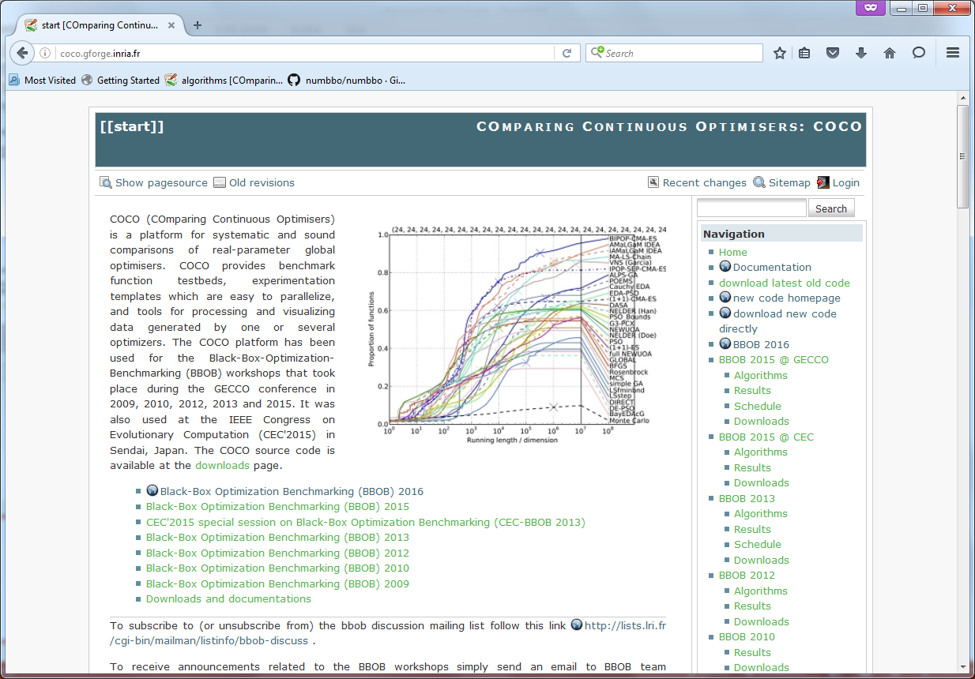
http://coco.gforge.inria.fr/

Slide 62
150 algorithms

Slide 63
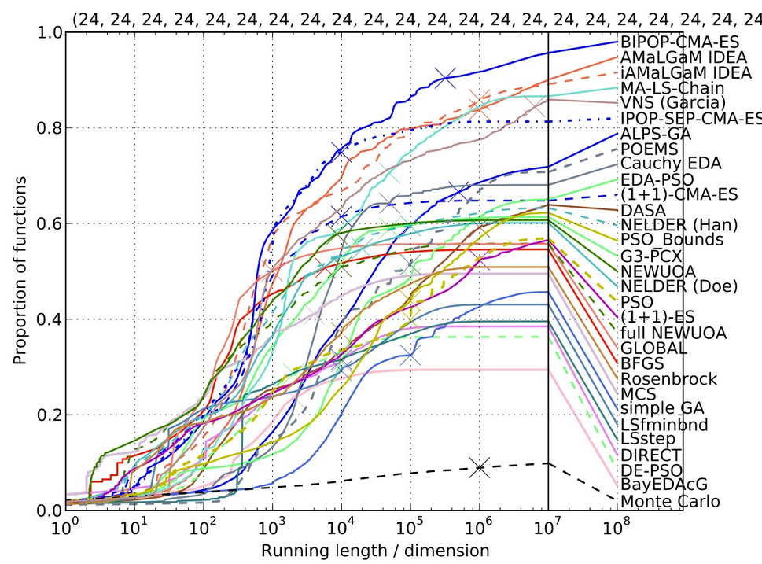
more representative set
of 31 algorithms
from BBOB-2009
dimension 10

Slide 64
Recommendations
Results of BBOB 2009-2015 (noiseless bbob test suite)
low dimension (2-D, 3-D), small budget: Nelder Mead (implementation by B. Doerr et al.)
very small budget (<50D funevals): BBOB-SMAC (an EGO variant)
larger dimension, small budget (<500D funevals): NEWUOA, MCS
larger dimension, large budget (>500D funevals): CMA-ES variants
portfolio algorithms can combine the best of all worlds, e.g. HCMA

Slide 65
Further Observations
Invariance
many algorithms are not invariant under affine transformations of the search space (for example PSO), others like CMA-ES variants are
as a consequence, other types of algorithms are good for separable and non-separable problems
Robustness of Algorithms
CMA-ES was tested in several variants, in several programming languages and with several, slightly changing settings
nevertheless, it showed throughout its variants consistently good behavior and can be considered as a robust algorithm if the budget is not too low

Slide 66
The Future of COCO
bi-objective data coming up (BBOB workshop@GECCO'16)
towards more realistic problems
constraints
"almost real-world" problems
online visualization of data
Thank you.....

Slide 67
GECCO workshop on
Black Box Optimization Benchmarking (BBOB'2016)
with a focus on bi-objective problems
organizers:
Anne Auger, Dimo Brockhoff, Nikolaus Hansen,
Tea Tušar, Dejan Tušar, Tobias Wagner
submission deadline: April 17, 2016
http://numbbo.github.io/workshops/BBOB-2016/
https://github.com/numbbo/coco

